Slide 1
Cornerstone City Church Peninsula Plus Community Hoo Are Ya
15th February 2026

Slide 2
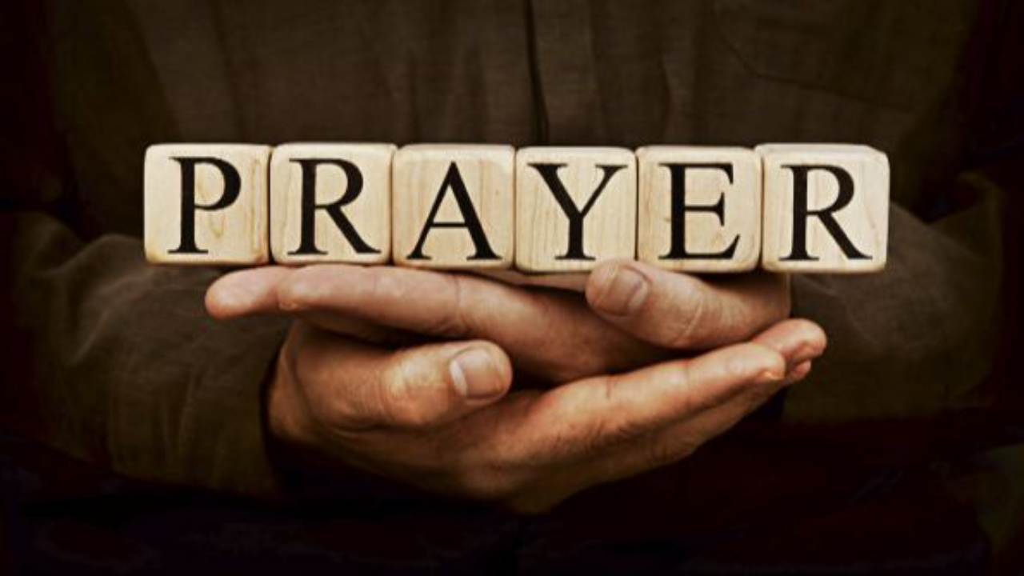

Slide 3
Come Now Is the Time To Worship
CCLI Song # 2430948
Brian Doerksen
© 1998 Vineyard Songs (UK/Eire) (Admin. by Integrity Music Ltd)
For use solely with the SongSelect® Terms of Use. All rights reserved. www.ccli.com
CCLI Licence No. 33265

Slide 4
1/5
Come now is the time to worship
Come now is the time to give your heart
Come just as you are to worship
Come just as you are before your God
Come

Slide 5
2/5
One day every tongue
Will confess You are God
One day every knee will bow
Still the greatest treasure remains
For those who gladly choose You now

Slide 6
3/5
Come now is the time to worship
Come now is the time to give your heart
Come just as you are to worship
Come just as you are before your God
Come

Slide 7
4/5
Willingly we choose to surrender our lives
Willingly our knees will bow
With all our heart soul mind and strength
We gladly choose You now

Slide 8
5/5
Come now is the time to worship
Come now is the time to give your heart
Come just as you are to worship
Come just as you are before your God
Come

Slide 9
Ancient Of Days
CCLI Song # 798108
Gary Sadler | Jamie Harvill
© 1992 Integrity's Hosanna! Music
For use solely with the SongSelect® Terms of Use. All rights reserved. www.ccli.com
CCLI License # 33265

Slide 10
1/4
Blessing and honor glory and power
Be unto the Ancient of Days
From ev'ry nation all of creation
Bow before the Ancient of Days

Slide 11
2/4
Ev'ry tongue in heaven and earth
Shall declare Your glory
Ev'ry knee shall bow at Your throne
In worship
You will be exalted O God
And Your kingdom shall not pass away
O Ancient of Days

Slide 12
3/4
Your kingdom shall reign
Over all the earth
Sing unto the Ancient of Days
For none can compare
To Your matchless worth
Sing unto the Ancient of Days (REPEAT)

Slide 13
4/4
Ev'ry tongue in heaven and earth
Shall declare Your glory
Ev'ry knee shall bow at Your throne
In worship
You will be exalted O God
And Your kingdom shall not pass away
O Ancient of Days

Slide 14
Open The Eyes of My Heart
CCLI Song # 2298355
Paul Baloche
© 1997 Integrity's Hosanna! Music (Admin. by Integrity Music Ltd)
For use solely with the SongSelect® Terms of Use. All rights reserved. www.ccli.com
CCLI Licence No. 33265

Slide 15
1/3
Open the eyes of my heart Lord
Open the eyes of my heart
I want to see You
I want to see You

Slide 16
2/3
To see You high and lifted up
Shining in the light of Your glory
Pour out Your power and love
As we sing holy holy holy

Slide 17
3/3
Holy holy holy
Holy holy holy
Holy holy holy
I want to see You

Slide 19
Living Hope CCLI Song # 7106807
Brian Johnson | Phil Wickham
© 2017 Phil Wickham Music; Simply Global Songs; Sing My Songs; Bethel Music Publishing
For use solely with the SongSelect® Terms of Use. All rights reserved. www.ccli.com
CCLI Licence No. 33265

Slide 20
1/6
How great the chasm that lay between us
How high the mountain I could not climb
In desperation I turned to heaven
And spoke Your name into the night
Then through the darkness Your loving-kindness
Tore through the shadows of my soul
The work is finished the end is written
Jesus Christ my living hope

Slide 21
2/6
Who could imagine so great a mercy
What heart could fathom such boundless grace
The God of ages stepped down from glory
To wear my sin and bear my shame
The cross has spoken I am forgiven
The King of kings calls me His own
Beautiful Savior I’m Yours forever
Jesus Christ my living hope

Slide 22
3/6
Hallelujah praise the One who set me free
Hallelujah death has lost its grip on me
You have broken every chain
There’s salvation in Your name
Jesus Christ my living hope

Slide 23
4/6
Then came the morning that sealed the promise
Your buried body began to breathe
Out of the silence the Roaring Lion
Declared the grave has no claim on me
(REPEAT)
Jesus Yours is the victory whoa

Slide 24
5/6
Hallelujah praise the One who set me free
Hallelujah death has lost its grip on me
You have broken every chain
There’s salvation in Your name
Jesus Christ my living hope

Slide 25
6/6
Jesus Christ my living hope
Oh God You are my living hope

Slide 27
Breathe (This is the Air) CCLI Song # 1874117
Marie Barnett
© 1995 Mercy / Vineyard Publishing
For use solely with the SongSelect® Terms of Use. All rights reserved. www.ccli.com
CCLI License # 33265

Slide 28
1/3
This is the air I breathe
This is the air I breathe
Your holy presence living in me
This is my daily bread
This is my daily bread
Your very word spoken to me

Slide 29
2/3
And I I'm desperate for You
And I I'm lost without You

Slide 30
3/3
This is the air I breathe
This is the air I breathe
This is the air I breathe
This is the air I breathe

Slide 31
1/1
Waiting here for You with our hands
Lifted high in praise
And it's You we adore
Singing alleluia

Slide 33
Holy Forever
CCLI Song # 7201044
Brian Johnson | Chris Tomlin | Jason Ingram | Jenn Johnson | Phil Wickham
© Phil Wickham Music (Admin. by / Small Stone Media BV, Holland (Admin. in the UK/Eire by Song Solutions www.songsolutions.org))
Simply Global Songs (Admin. by / Small Stone Media BV, Holland (Admin. in the UK/Eire by Song Solutions www.songsolutions.org))
Capitol CMG Paragon (Admin. by Capitol CMG Publishing)
S. D. G. Publishing (Admin. by Capitol CMG Publishing)
Be Essential Songs (Admin. by Essential Music Publishing LLC)
My Magnolia Music (Admin. by Essential Music Publishing LLC)
Bethel Music Publishing (Admin. by Song Solutions)
Brian and Jenn Publishing (Admin. by Song Solutions)
For use solely with the SongSelect® Terms of Use. All rights reserved. www.ccli.com
CCLI Licence No. 33265

Slide 34
1/10
A thousand generations falling down in worship
To sing the song of ages to the Lamb
And all who've gone before us
And all who will believe
Will sing the song of ages to the Lamb

Slide 35
2/10
(Jesus) Your name is the highest
Your name is the greatest
Your name stands above them all
All thrones and dominions
All powers and positions
Your name stands above them all

Slide 36
3/10
And the angels cry Holy
All creation cries Holy
You are lifted high Holy
Holy forever

Slide 37
4/10
If you've been forgiven and if you've been redeemed
Sing the song forever to the Lamb
If you walk in freedom and if you bear His name
Sing the song forever to the Lamb
We'll sing the song forever and amen

Slide 38
5/10
And the angels cry Holy
All creation cries Holy
You are lifted high Holy
Holy forever

Slide 39
6/10
Hear Your people sing Holy
To the King of Kings Holy
You will always be Holy
Holy forever

Slide 40
7/10
(Jesus) Your name is the highest
Your name is the greatest
Your name stands above them all
All thrones and dominions
All powers and positions
Your name stands above them all

Slide 41
8/10
And the angels cry Holy
All creation cries Holy
You are lifted high Holy
Holy forever

Slide 42
9/10
Hear Your people sing Holy
To the King of Kings Holy
You will always be Holy
Holy forever

Slide 43
10/10
You will always be Holy
Holy forever

Slide 44
1/1
You are worthy of it all
You are worthy of it all
For from You are all things
And to You are all things
You deserve the glory

Slide 45


Slide 46
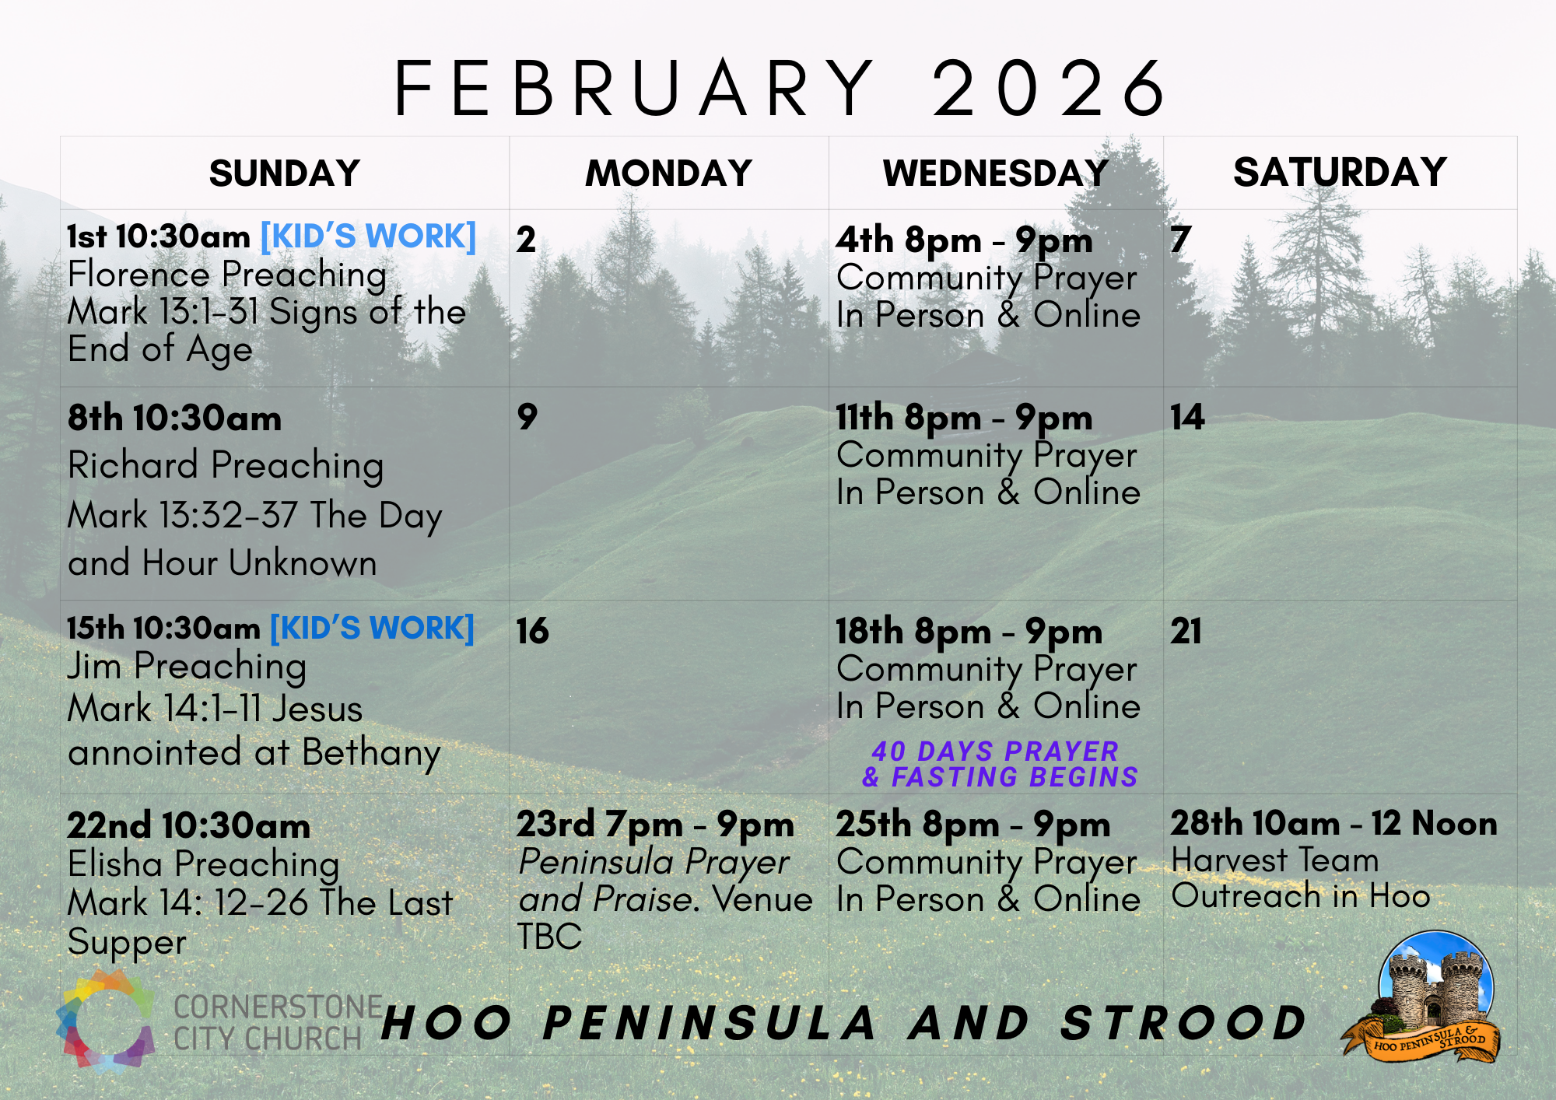

Slide 47
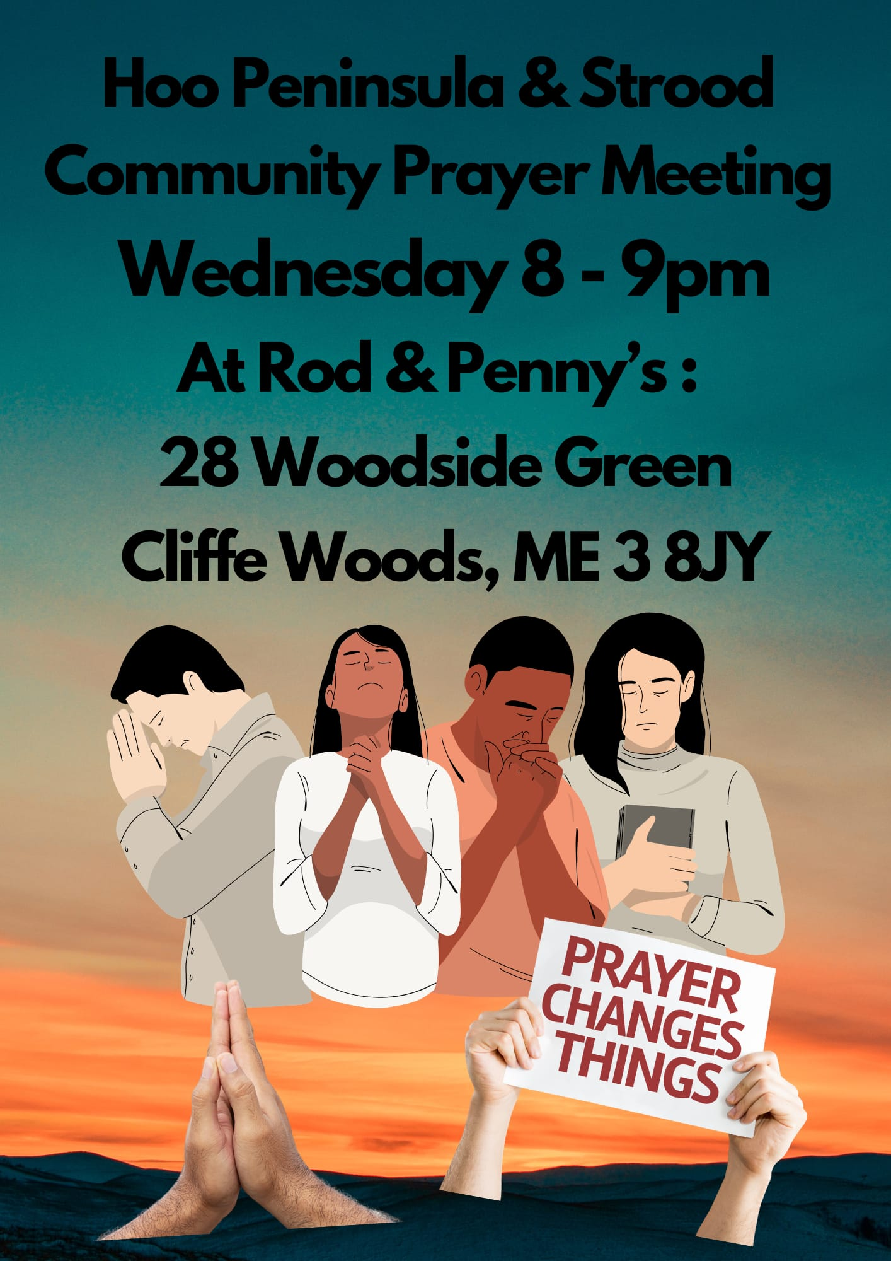

Slide 48
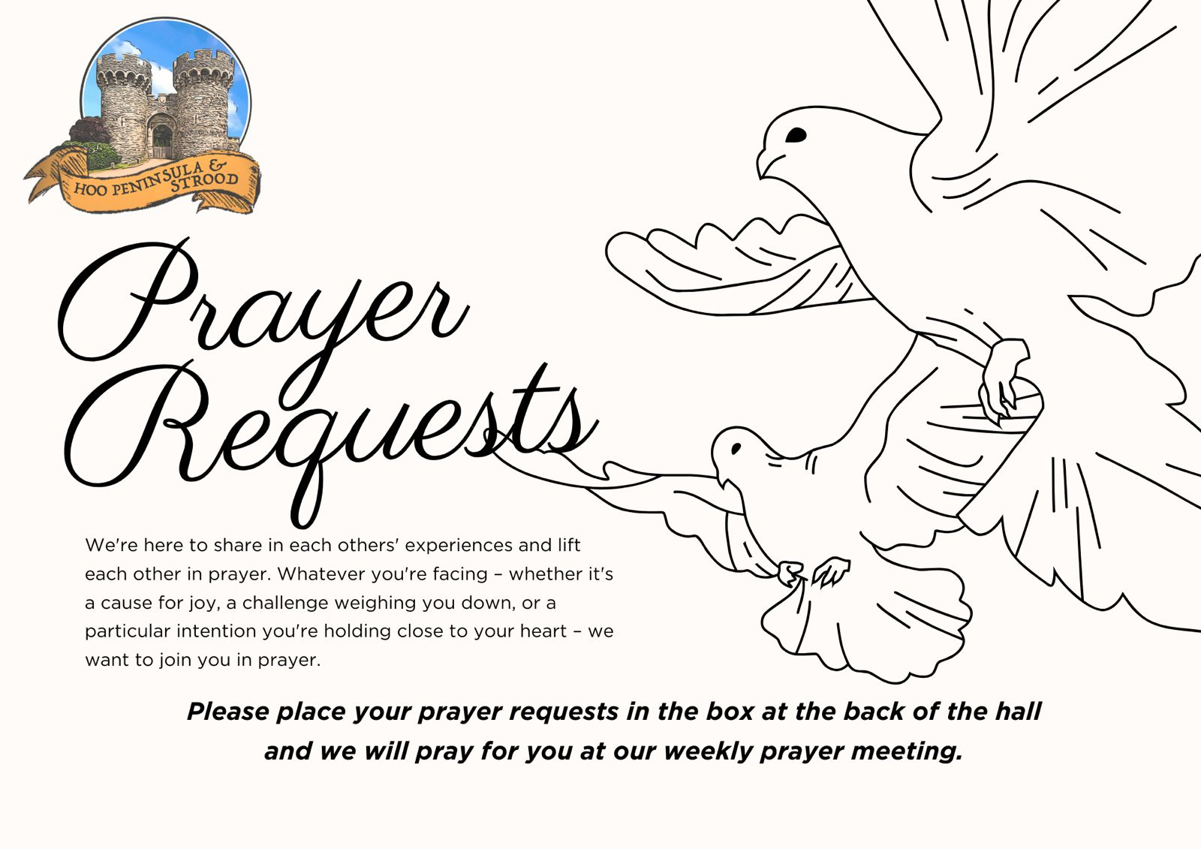

Slide 49


Slide 50
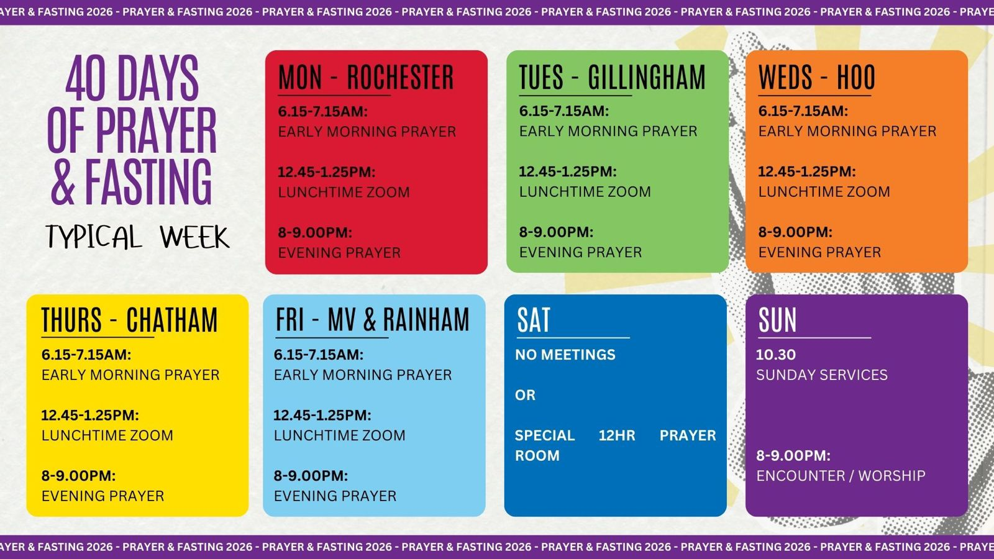

Slide 51
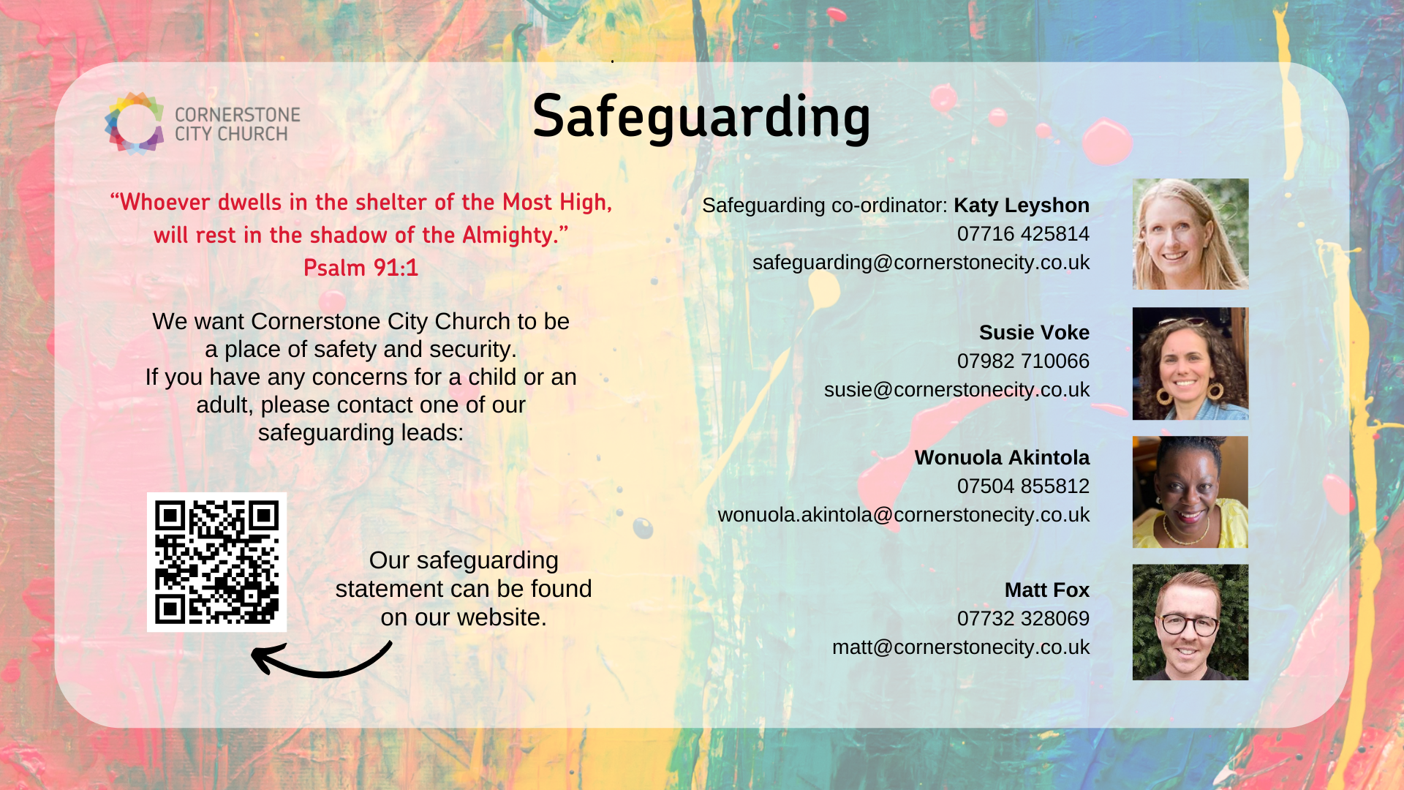

Slide 52


Slide 53


Slide 54
2 Corinthians 14 May the grace of the Lord Jesus Christ, and the love of God, and the fellowship of the Holy Spirit be with us all. And….
Surely goodness and mercy shall follow us all the days of our lives, and we shall dwell in the house of the Lord forever.

